Slide 1
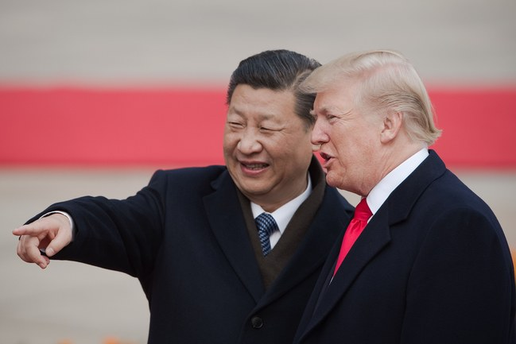
Is China Winning the Trade War ?
https://www.newyorker.com/news/our-columnists/why-china-is-winning-the-trade-war

Slide 2
Distributed Representation of Chinese Collocation

Slide 3
Compulsory English lesson
Unit 4 Wildlife Protection 一课中出现的词块有：
1 decrease to 减少到 2. decrease by 减少了
3. die out 灭亡 4. loss of缺少
5. in peace 和平地 6. in danger of 处于危险中
7. burst into laughter 突然大笑 8. protect…from…保护…不受(伤害)
9.appreciate doing sth 感激做某事 10. long before 很久以前
11.before long 很快，不久 12. come into being 形成
13.for sure 一定要，必须 14.so that 以致于，为了
15.in relief 如释重负，松了口气 16.pat attention to 注意
17.according to 按照，根据 18.in such a short time 在如此短的时间内
19. have an effect on 对…产生影响 20. succeed in doing sth 成功地做某事

Slide 4


